Slide 1

NAIVE REINFORCEMENT LEARNING ON ATARI GAMES
Mentor :- Dr. Manish Kumar Bajpai (Assistant Professor, CSE Dept. IIITDM Jabalpur)
Kshitij Kumar Singh (2018124)
Raj Agrawal Mohit (2018201)
Pravesh Vajpayee (2018194)

Slide 2
BRIEF INTRODUCTION AND PROBLEM STATEMENT
Our objective is to implement different RL algorithms on Atari Games and compare their performance and draw conclusions.
We choosed SARSA , Q Learning algorithms
These algorithms were implemented over Atari Games like “Breakout-ram-v0” and "FrozenLakeNoSlip-v0"
Improving the performance using other RL techniques if possible.

Slide 3
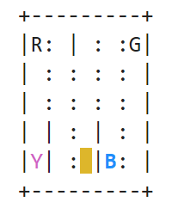
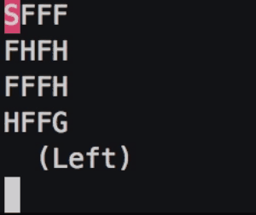
Environments
Taxi-V2 FrozenLake-v0
States: 500 States:16
Action: 6 Action:4

Slide 4
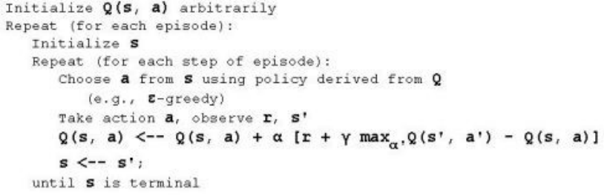
IMPLEMENTATION
Naive Q Learning
Q(s, a) ← Q(s, a) +α(R(s) + γ arg maxa Q(s 0 , a0 ) − Q(s, a)).

Slide 5
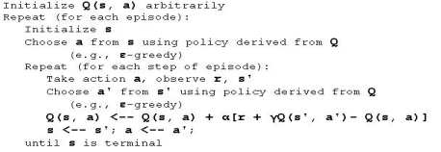
SARSA
Q(s, a) ← Q(s, a) + α(R(s) + γQ(s 0 , a0 ) − Q(s, a))

Slide 6
Implementation Result
SARSA converges faster compare to Naive Q as it takes the epsilon probability of random action into account when updating its policy. However there does not seem to be any difference between their initial performance and final performance of both the algorithms.
Our conclusion is that the problem may lie in the non-markovian nature of this environment, as our implementation only takes into account the current state when deciding which action to take.

Slide 7
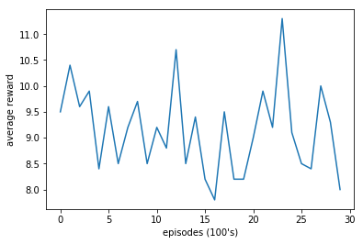
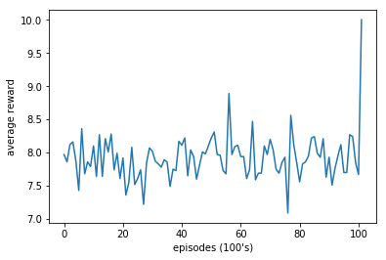
Continued...

Slide 8
Improvement
We can improve the performance by Deep Q-Learning using Experience Replay, as using Experience Replay allows it to use a history of states to determine action, solving the problem of non-markovian property.
Q learning with Neural Network in Tensorflow finds optimal policy a little bit faster than the other agent which uses the q table to store q values and it is more stable than normal Q learning approach.
It can be further improved by using Fast Q Learning with Experience Replay with Neural Network which will further improve the efficiency of Training in Q learning.

Slide 9
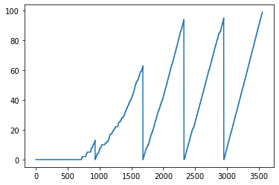
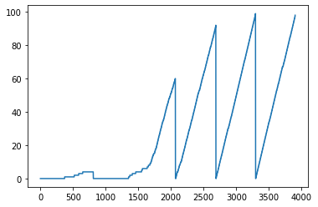
Q Learning with Neural Network and Fast Experience Replay
Total Rewards
Total Rewards in 100 episod
Episodes
Episodes

Slide 10
CONCLUSION
Both Deep Q-Learning using Experience Replay and Fast Q Learning with Experience Replay with Neural Network converges on non-markovian environments, and it's also allows to use a history of states to determine action.
SARSA Converge faster than Naive Q Learning
Experience replay with Neural Network in Q learning helps to speed up the training efficiency.
Q learning with Neural Network in Tensorflow finds optimal policy a little bit faster than the other agent which uses the q table to store q values and it is more stable than normal Q learning approach.

Slide 11
References
[1] Andrew G.Barto Richard S.Sutton, Reinforcement Learning An Introduction, The MIT Press, 2018.
[2] “Taxi-v2,” 2011.
[3] Peter Norvig Stuart Russel, Artificial Intelligence A Modern Approach, Pearson, 2010. [4] “Monte carlo tree search,” 2010.
[4] “Implementing deep reinforcement learning models with tensorflow + openai gym,” 2018. [6] “Playing atari with deep reinforcement learning,” 2013.
[5] https://www.geeksforgeeks.org/
[6] www.cse.unsw.edu.au
[7] https://towardsdatascience.com/deep-q-network-dqn-ii-b6bf911b6b2c
[8] https://www.youtube.com/channel/UCUbeqkIVP808fEP0ae-_akw
[9] https://stackoverflow.com/

Slide 12
Thank You

